Slide 1


Breast Cancer Detection
Emma Korycki
ekory003@ucr.edu
Dec 4, 2025
UC Riverside, ECE 16 Data Science for Engineering Applications

Slide 2
Python libraries and Tools:
import pandas as pd
from scipy import stats
import numpy as np
import matplotlib.pyplot as plt
from sklearn.cluster import KMeans
import seaborn as sns
from scipy.stats import chi2_contingency
from sklearn.preprocessing import StandardScaler
from sklearn.neural_network import MLPClassifier
from sklearn.metrics import accuracy_score, classification_report
from sklearn.utils import resample
from sklearn.decomposition import PCA
from sklearn.metrics import accuracy_score, precision_score, recall_score, f1_score, confusion_matrix, classification_report
import tensorflow as tf
from tensorflow.keras import Sequential
from tensorflow.keras.layers import Dense, Input
from tensorflow.keras.metrics import Recall
from keras_tuner import RandomSearch, Objective
from keras_tuner.tuners import RandomSearch
UC Riverside, ECE 16 Data Science for Engineering Applications
Notes:
You can do it on a mobile phone

Slide 3
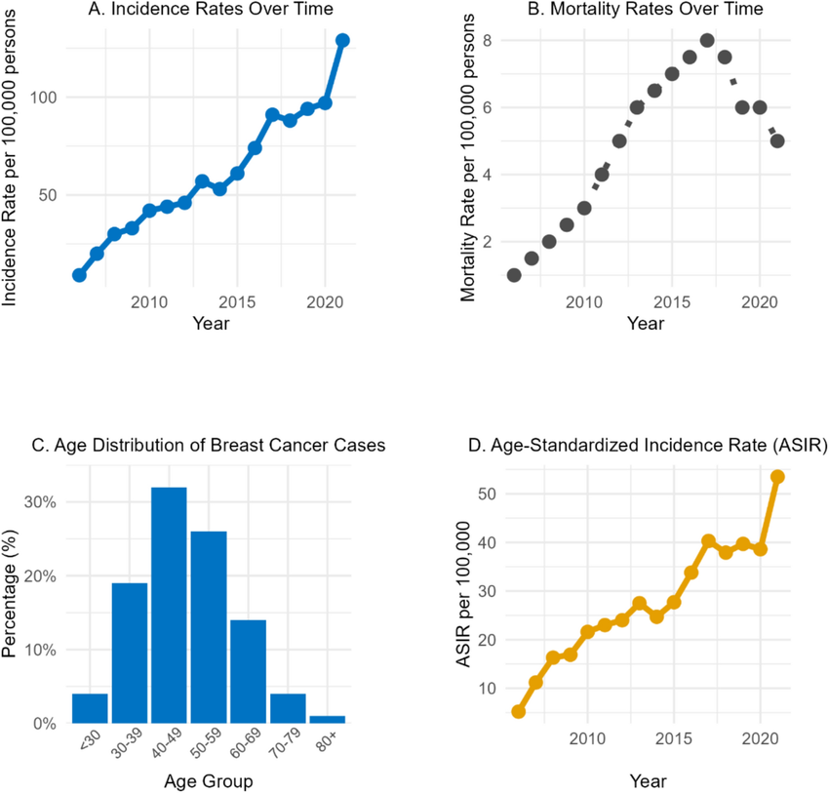
Introduction:
Breast cancer is the one of the most common cancer cases among women worldwide, and a leading cause of cancer-related deaths among women in the U.S
Makes up for ⅓ of all new cancer diagnosis in women each year(Source: American Cancer Society)
A comprehensive epidemiological analysis of breast cancer in the Eastern Province of Saudi Arabia - Scientific Figure on ResearchGate.
UC Riverside, ECE 16 Data Science for Engineering Applications
Notes:
https://www.cdc.gov/breast-cancer/statistics/index.html
https://www.cancer.org/cancer/types/breast-cancer/about/how-common-is-breast-cancer.html

Slide 4
Issue: Accuracy
Current cancer screening methods such as mammography and ultrasounds, provide early detection, yet pose major limitations:
False positives cause patient anxiety and financial burden
False-negatives can dangerously delay diagnosis and treatment.
  Mammograms miss about 1 in 8 breast cancers.(American Cancer Society)
The ability to accurately classify breast tumors as benign or malignant early on is crucial for improving survival rates and patient well-being.
Notes:
https://www.cancer.org/cancer/types/breast-cancer/screening-tests-and-early-detection/mammograms/limitations-of-mammograms.html

Slide 5
Data Exploration:
Using tabular data(Mass Case Description Set) from: CBIS-DDSM (Curated Breast Imaging Subset of the Digital Database for Screening Mammography)
  updated version of the DDSM
    makes it public, curated, and standardized for ”evaluation of future computer-aided diagnosis-CADx and detection-CADe systems.”
Contains 892 total breast cancer samples
  691 for training and 201 for testing

Slide 6
Data Exploration: Tabular Features
breast density(range 1-4)
left or right breast
image view
  (CC (craniocaudal, or overhead angle)
  MLO (mediolateral oblique, or side angle))
abnormality id(1-6)
abnormality type(mass)
mass shape, can be one or combination of the following:
  oval, round, irregular, lobulated, architectural distortion, lymph node, focal asymmetric density, asymmetric breast tissue
mass margins, can be one or combination of the following:
  spiculated, ill defined, circumscribed, obscured, microlobulated)
assessment(0-6)
pathology(malignant, benign, benign without callback)
subtlety(0-5)

Slide 7
patient_id | breast_density | left or right breast | image view | abnormality id | abnormality type | mass shape | mass margins | assessment | pathology | subtlety
P_00001 | 3 | LEFT | CC | 1 | mass | IRREGULAR-ARCHITECTURAL_DISTORTION | SPICULATED | 4 | MALIGNANT | 4
P_00001 | 3 | LEFT | MLO | 1 | mass | IRREGULAR-ARCHITECTURAL_DISTORTION | SPICULATED | 4 | MALIGNANT | 4
P_00004 | 3 | LEFT | CC | 1 | mass | ARCHITECTURAL_DISTORTION | ILL_DEFINED | 4 | BENIGN | 3
P_00004 | 3 | LEFT | MLO | 1 | mass | ARCHITECTURAL_DISTORTION | ILL_DEFINED | 4 | BENIGN | 3
P_00004 | 3 | RIGHT | MLO | 1 | mass | OVAL | CIRCUMSCRIBED | 4 | BENIGN | 5
P_00009 | 3 | RIGHT | CC | 1 | mass | OVAL | ILL_DEFINED | 4 | MALIGNANT | 4
P_00009 | 3 | RIGHT | MLO | 1 | mass | OVAL | ILL_DEFINED | 4 | MALIGNANT | 4
P_00015 | 3 | LEFT | MLO | 1 | mass | IRREGULAR | ILL_DEFINED-SPICULATED | 4 | MALIGNANT | 4
P_00018 | 2 | RIGHT | CC | 1 | mass | OVAL | CIRCUMSCRIBED | 4 | BENIGN | 5
P_00018 | 2 | RIGHT | MLO | 1 | mass | OVAL | CIRCUMSCRIBED | 4 | BENIGN | 5
P_00021 | 1 | LEFT | CC | 1 | mass | OVAL | CIRCUMSCRIBED | 3 | BENIGN | 5
P_00021 | 1 | LEFT | MLO | 1 | mass | OVAL | CIRCUMSCRIBED | 3 | BENIGN | 5
P_00021 | 1 | RIGHT | CC | 1 | mass | OVAL | CIRCUMSCRIBED | 3 | BENIGN | 5
P_00021 | 1 | RIGHT | MLO | 1 | mass | OVAL | CIRCUMSCRIBED | 3 | BENIGN | 5

Slide 8
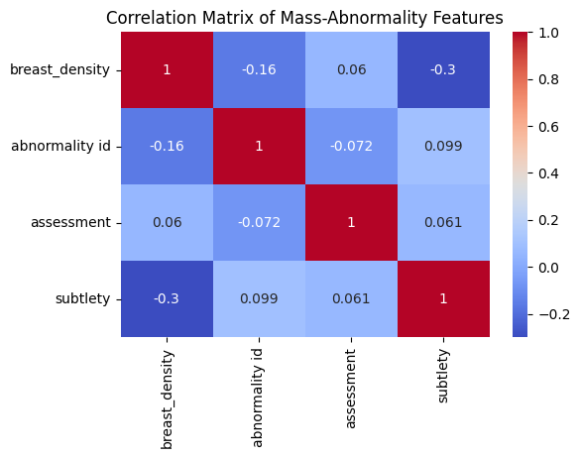
Data Cleaning/Preprocessing:
Dropped rows with missing values (N/A)
Kept all numerical features ⇒ ⇒ ⇒
Performed Chi-Square on categorical features
  Selected categorical features: mass shape, mass margins, pathology
    p-value = 0.0
Converted categorical features to numerical features:
  one-hot encoding for pathology columns(single labels)
  multi-label binarization for mass shape and mass margins(multiple labels, can be one of combination of them)
    separated labels into separate columns
Calculated correlation between numerical features: breast density, abnormality id, assessment, subtlety
No two numerical features are strongly correlated with each other: features all independent

Slide 9
 | patient_id | breast_density | abnormality id | assessment | subtlety | pathology_BENIGN | pathology_BENIGN_WITHOUT_CALLBACK | pathology_MALIGNANT | shape_is_ARCHITECTURAL_DISTORTION | shape_is_ASYMMETRIC_BREAST_TISSUE | shape_is_FOCAL_ASYMMETRIC_DENSITY | shape_is_IRREGULAR | shape_is_LOBULATED | shape_is_LYMPH_NODE | shape_is_OVAL
0 | P_00001 | 3 | 1 | 4 | 4 | False | False | True | 1 | 0 | 0 | 1 | 0 | 0 | 0
1 | P_00001 | 3 | 1 | 4 | 4 | False | False | True | 1 | 0 | 0 | 1 | 0 | 0 | 0
2 | P_00004 | 3 | 1 | 4 | 3 | True | False | False | 1 | 0 | 0 | 0 | 0 | 0 | 0
3 | P_00004 | 3 | 1 | 4 | 3 | True | False | False | 1 | 0 | 0 | 0 | 0 | 0 | 0
4 | P_00004 | 3 | 1 | 4 | 5 | True | False | False | 0 | 0 | 0 | 0 | 0 | 0 | 1
... | ... | ... | ... | ... | ... | ... | ... | ... | ... | ... | ... | ... | ... | ... | ...
1268 | P_02033 | 2 | 1 | 3 | 4 | False | False | True | 0 | 0 | 0 | 1 | 0 | 0 | 0
1269 | P_02079 | 2 | 1 | 3 | 5 | False | False | True | 0 | 0 | 0 | 0 | 0 | 0 | 0
1270 | P_02079 | 2 | 1 | 3 | 5 | False | False | True | 0 | 0 | 0 | 0 | 0 | 0 | 0

Slide 10
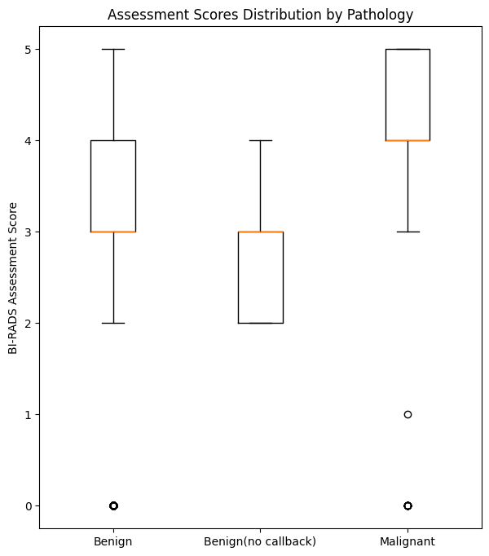
Plots: Boxplot
Visualizes assessment(BI RADS) scores for train dataset.
Scores range from 0-6 to assess risk,
  0: incomplete exam,
  1: no cancer
  5: highly suggestive of cancer
  6: known biopsy-proven cancer.
Benign:
  Outlier at 0, minimum at 2, median at 3.5, and maximum at 5
Benign without callback:
  No outliers, minimum at 2, median at 2.5, and maximum at 4
Malignant:
  Outliers at 0 and 1, minimum at 3, median at 4.5, and maximum at 5.

Slide 11
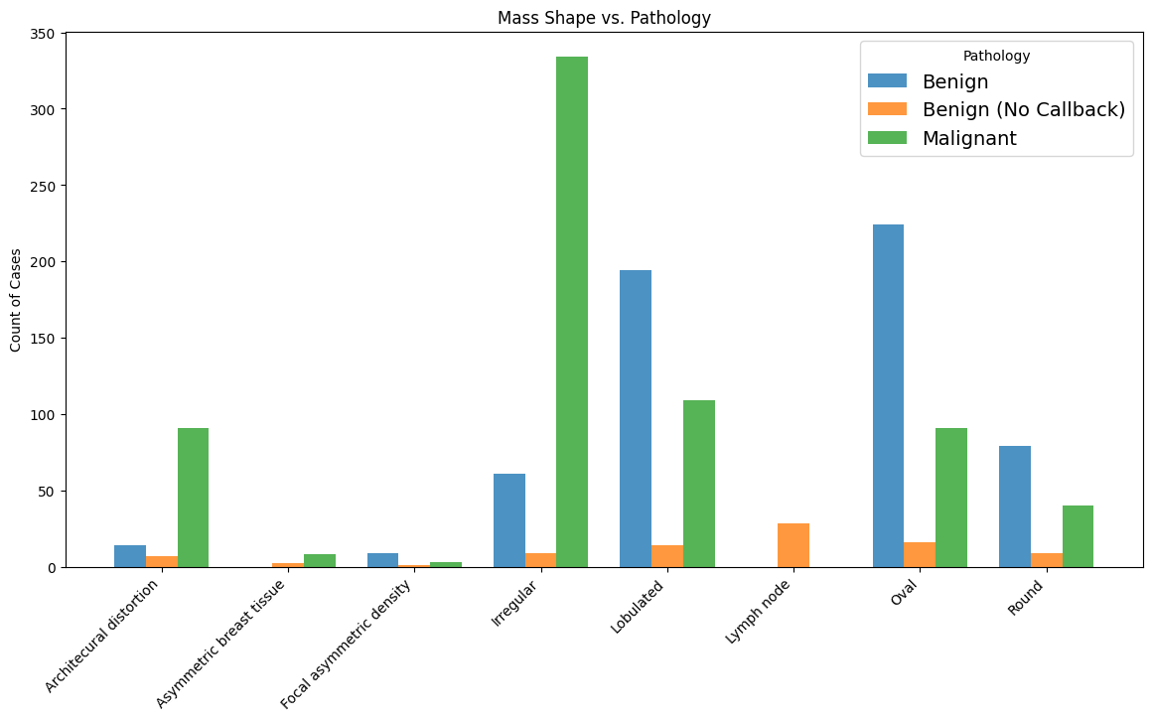
Plots: Bar Graph
Masses that are irregular or have architecural distortion are most common with malignancy
Masses that are oval and lobulated shape account for majority of benign cases.
Round masses have similar counts for benign and malignant masses
All lymph node cases are benign without callback

Slide 12
Machine Learning Model
I want to predict if a mass is a malignant tumor given the mass features(mass shape, mass margins, breast density, abnormality id, assessment, subtlety)
Probabilistic Classification: I used an ANN to output the model’s confidence that a case is malignant
  Confidence scores are useful because they indicate level of clinical concern
Binary conversion: Confidence score converted into binary label(0 or 1) for calculating metrics like Accuracy and Recall
  Uses classification threshold(If score > 0.5, then label is 1(Malignant))
Resampling: for class imbalance(more benign data than malignant)

Slide 13
Hyperparameters
Used Keras Tuner to tune hyperparameters by Random Search
  Optimizes model for best performance
Parameters:
Learning rate
Optimizer(adam vs. SGD)
Number and size of hidden layers
Activation Functions
  Output layer: Sigmoid
    for probabilistic classification
  Hidden layers: ReLu
Objective: maximize recall
  Reduces False Negatives
Loss Function: binary_crossentropy
  for binary classification
Metrics: Accuracy and Recall
  Tracked during training

Slide 14
Results(Before Hyperparameter Tuning)
Train Accuracy: 83.23% of all train predictions were correct
Test Accuracy: 76.18% of all test predictions were correct
Test Precision: 75.27% of the models predictions for malignancy were actually malignant
Recall: Successfully found 75.67% of malignant tumors
  False positive rate: 24.33%
F1-score:The harmonic mean of precision and recall was 75.43%
Issues:
Overfitting
High false positive rate
Confusion Matrix(Counts):
True Negatives: 169 | False Positives: 47
False Negatives: 39 | True Positives: 106

Slide 15
Best Results(After Hyperparameter Tuning)
Train Accuracy: 87.87% of all train predictions were correct
Test Accuracy: 78.97% of all test predictions were correct
Test Precision: 78.21% of the models predictions for malignancy were actually malignant
Recall: Successfully found 79.01% of malignant tumors
  False positive rate: 20.99%
F1-score:The harmonic mean of precision and recall was 78.45%
Confusion Matrix(Counts):
True Negatives: 170 | False Positives: 46
False Negatives: 30 | True Positives: 115

Slide 16
Worst Results(Dimensionality Reduction After Hyperparameter Tuning)
Reduced number of features (12 to 10)
Train Accuracy: 64.37% of all train predictions were correct
Test Accuracy: 55.68% of all test predictions were correct
Test Precision: 56.27% of the models predictions for malignancy were actually malignant
Recall: Successfully found 56.50% of malignant tumors
  False positive rate: 34.50%
F1-score:The harmonic mean of precision and recall was 55.47%
Confusion Matrix(Counts):
True Negatives: 113 | False Positives: 103
False Negatives: 57 | True Positives: 88

Slide 17
Conclusion and Next Steps:
Developed an ANN to predict the malignancy of masses using the Mass-case descriptions from the CBIS-DDSM dataset
Adressed class imbalance by resampling and tuned hyperparameters to combat overfitting, low recall, and class imbalance
Model achieved balance performance
  F1 score: 78.45%
Biggest concern was false negative rate:
  Lowest achieved: 20.99%

Slide 18
Limitations
Next steps
Gap persists between Training Accuracy (87.87%) and Test Accuracy (78.97%)
Lacks richness of raw image data
Threshold: Metrics used 50% threshold
  Threshold could be tuned to balance the cost of false negatives vs. false positives
Ensemble learning: Combine ANN with other models
  Random Forests: Uses many decision trees to make predictions
For maximum accuracy, transition to inclusion of raw image data through a Convolutional Neural Network(CNN) approach

Slide 19
Sources:
Almohanna, H., Almsned, F., Alharbi, H., Dossary, N., Alrasheed, A., Alzayer, R., & Alwosaibai, K. (2025). A comprehensive epidemiological
analysis of breast cancer in the Eastern Province of Saudi Arabia. Scientific Reports, 15. https://doi.org/10.1038/s41598-025-05276-7
American Cancer Society. (2022, January 14). Limitations of mammograms | How accurate are mammograms?
https://www.cancer.org/cancer/types/breast-cancer/screening-tests-and-early-detection/mammograms/limitations-of-mammograms.html
American Cancer Society. (2024, January 12). Key statistics for breast cancer.
https://www.cancer.org/cancer/types/breast-cancer/about/how-common-is-breast-cancer.html
Centers for Disease Control and Prevention. (2024, February 26). Breast cancer statistics.
https://www.cdc.gov/breast-cancer/statistics/index.html
Kashyap, P. (2024, November 2). Mastering hyperparameter tuning for neural networks with Keras Tuner. Medium.
https://medium.com/@piyushkashyap045/mastering-hyperparameter-tuning-for-neural-networks-with-keras-tuner-c0b64d549188
Sawyer-Lee, R., Gimenez, F., Hoogi, A., & Rubin, D. (2016). Curated Breast Imaging Subset of Digital Database for Screening Mammography
(CBIS-DDSM) [Data set]. The Cancer Imaging Archive. https://doi.org/10.7937/K9/TCIA.2016.7O02S9CY

